Slide 1


KAMLA NEHRU INSTITUTE OF TECHNOLOGY
DEPARTMENT OF COMPUTER SCIENCE AND ENGINEERING
SESSION 2023-24
PRESENTED TO: PROF. SOHIT SHUKLA
PRESENTED BY: DIKSHANT, AVIDHA, SAKSHI KUMARI, LALIT KUMAR

Slide 2

TABLE OF CONTENTS
01
02
03
04
05
06
Introduction
Objectives
Survey
Methodology
Hardware Requirements
Software Requirements
07
08
Technology
PERT

Slide 3

VIRTUAL-CART
(E-COMMERCE WEBSITE)

Slide 4


INTRODUCTION
The purpose of Online E-commerce System is to automate the existing manual system by the help of computerized equipment’s and full-fledged computer software
E-commerce works by connecting buyers and sellers using various electronic channels, enabling secure and efficient transactions.
E-commerce has experienced rapid growth since its humble beginnings, with sales projected to grow significantly by 2024

Slide 5
Objectives
> Objective of the Project :
The Objective of this project is to create an e-commerce web portal with content management system which would allow product information to be updated securely

Slide 6

Survey
Amazon
Flipkart
Myntra
Boasts an extensive range of products, numerous seller options, and convenient services.
Leading e-commerce platform based in India, offering a vast array of products across multiple categories.
Focuses on fashion and casual lifestyle products, and is among the top e-commerce companies in India.

Slide 7

Methodology
Backend Development
Utilizes Node.js, Express.js, and MongoDB for backend development and data management.
Frontend Development
Employs HTML, CSS, JavaScript, and React.js to create interactive and dynamic user interfaces.
Testing and Quality Assurance
Includes unit testing, integration testing, and user acceptance testing to ensure a seamless and functional platform.

Slide 8

Hardware requirements
HD display monitor
Ethernet or Wi-Fi
8GB RAM
120 GB SSD (min)

Slide 9

SOFTWARE REQUIREMENT
Tools :
VSCode, Git, GitHub, Postman
Operating system :
Windows, MacOS, Linux

Slide 10
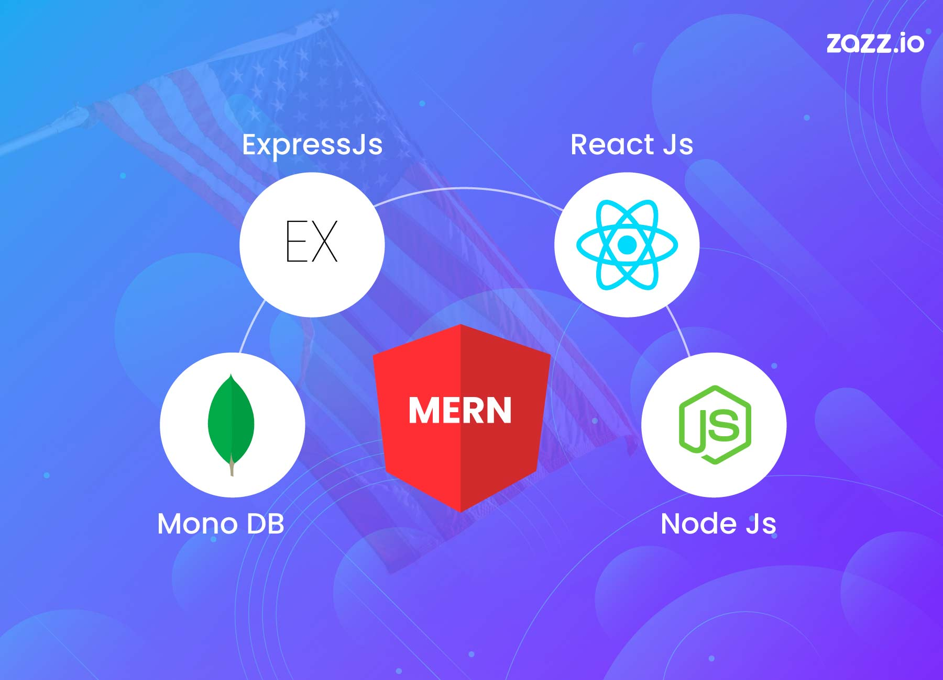
TECHNOLOGY
Front-end :
Back-end :
Database :
NextJs,ReactJS,
CSS
ExpressJS , NodeJS,
Javascript
MongoDB

Slide 11
PERT
Project Initialization :
Objective
Scope
Market Research
1 WEEK
Requirements Analysis :
Gather User requirements
Technical requirements
2 WEEK
System Design
Create Wire-frame
User Interface
2 WEEK
Development
Front-end
Back-end
Database setup
10 WEEK

Slide 12
Deployment
Cloud hosting
Platform deployment
Performance monitoring
1 WEEK
Testing
Integration testing
Bug fixing
2 WEEK
Project Closure
Documentation
Evaluation of project
2 WEEK

Slide 13

THANK YOU

